Slide 1
Creating GUIs with MATLAB
Concordia University
Department of Computer Science and Software Engineering
SOEN385
Control Systems and Applications

Slide 2
Creating GUIs
The process involves two tasks:
  Laying out GUI components
    GUIs are implemented as figure windows
    GUIDE (GUI Design Environment)
  Programming GUI components
    Writing callback functions to perform the desired action

Slide 3
GUIDE
Graphical User Interface Design Environment:
  Layout editor enables you to populate a GUI by clicking and dragging GUI components.
  Generates a MATLAB function that contains code to handle the initialization and launching of the GUI.
    Contains the callback functions.

Slide 4
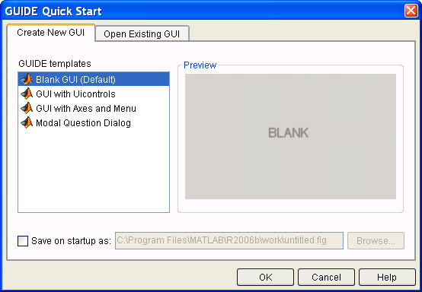
GUIDE
Type guide at the command prompt to open GUIDE

Slide 5
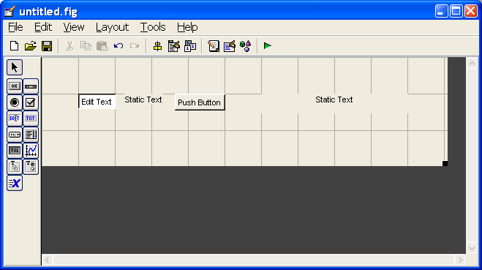
Example: Simple GUI
Factorial calculator (using VPA):
  Start with a blank GUI and place the GUI components (uicontrol objects):

Slide 6
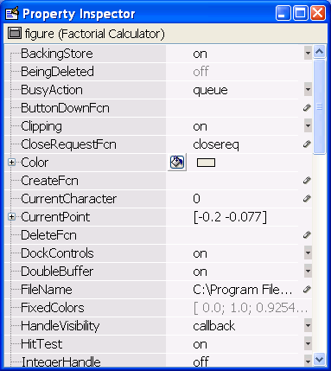
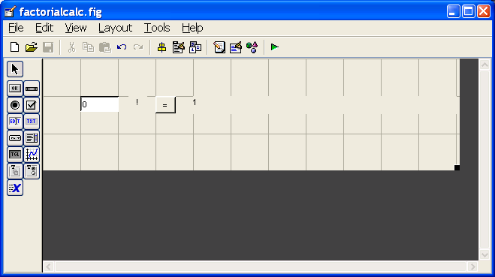
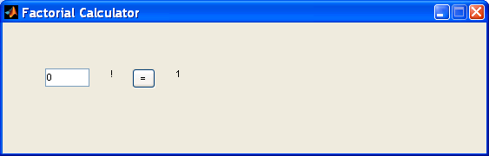
Example: Factorial Calculator
Resize, rename and modify the components look and feel:

Slide 7
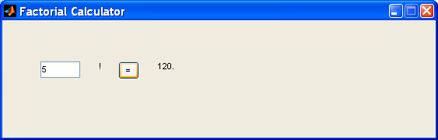
Example: Factorial Calculator
Edit the callback function of the push button:
% --- Executes on button press in pushbutton1.
function pushbutton1_Callback(hObject, eventdata, handles)
% hObject handle to pushbutton1 (see GCBO)
% eventdata reserved - to be defined in a future version of MATLAB
% handles structure with handles and user data (see GUIDATA)
str = get(handles.edit1, 'String');
set(handles.text2, 'String', char(vpa([str '!'])));
Run it again:

Slide 8
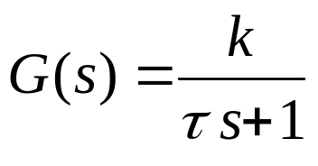
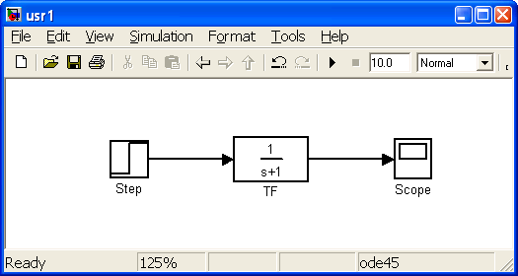
Example: Interaction with Simulink
Unit Step Response First Order System
Simulink Model

Slide 9
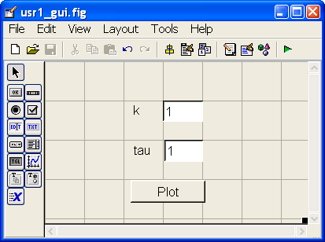
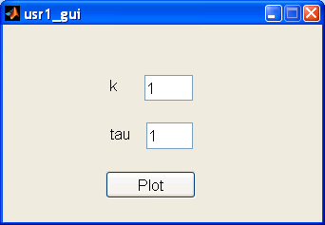
Example: Interaction with Simulink
GUI

Slide 10
Example: Interaction with Simulink
Edit the callback function of the push button:
% --- Executes on button press in pushbutton1.
function pushbutton1_Callback(hObject, eventdata, handles)
% hObject handle to pushbutton1 (see GCBO)
% eventdata reserved - to be defined in a future version of MATLAB
% handles structure with handles and user data (see GUIDATA)
k = get(handles.edit1, 'String');
tau = get(handles.edit2, 'String');
num = ['[' k ']'];
den = ['[' tau ', 1]'];
run('usr1');
set_param('usr1/TF', 'Numerator', num);
set_param('usr1/TF', 'Denominator', den);
sim('usr1');

Slide 11
References
MATLAB 7
Creating Graphical User Interfaces
http://www.mathworks.com/access/helpdesk/help/pdf_doc/matlab/buildgui.pdf

